Slide 1
Cup of Sugar
By Bryan Gallardo, Vatsal Pandya, Sergio Ruelas Kieri & Edmundo Meza

Slide 2

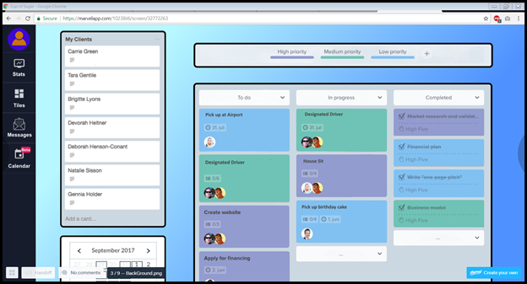

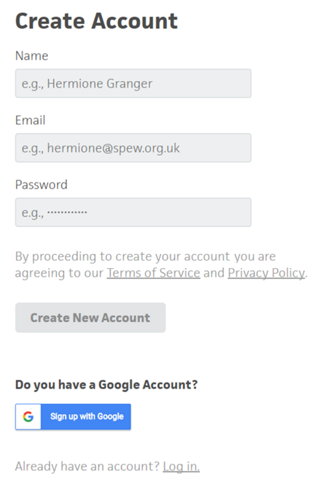
Abstract
In a city people have anonymity, are less likely to know their neighbor and have a sense of community. When people have a lack of community they are unable to have that societal help to solve everyday problems.
We want to build a community where people interact with their neighbors through small favors. This can be anything from borrowing a calculator before an exam or getting a ride to the airport.

Slide 3
Functional Requirements
User - Registration
Asking for a Cup of Sugar
Lending a Cup of Sugar
User Rating
User History

Slide 4
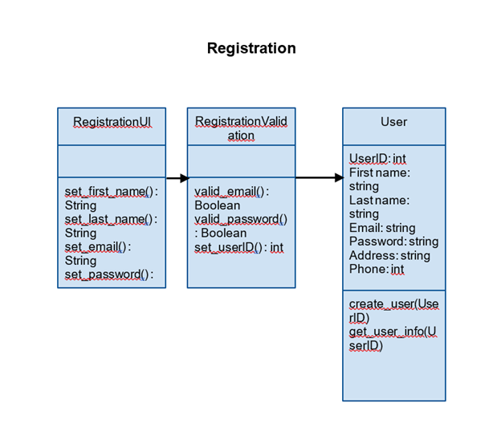
Registration Class Diagram

Slide 5
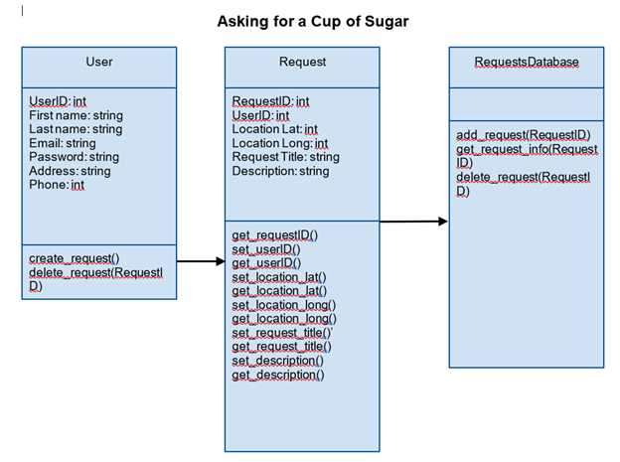
Asking for a Cup of Sugar Class Diagram

Slide 6
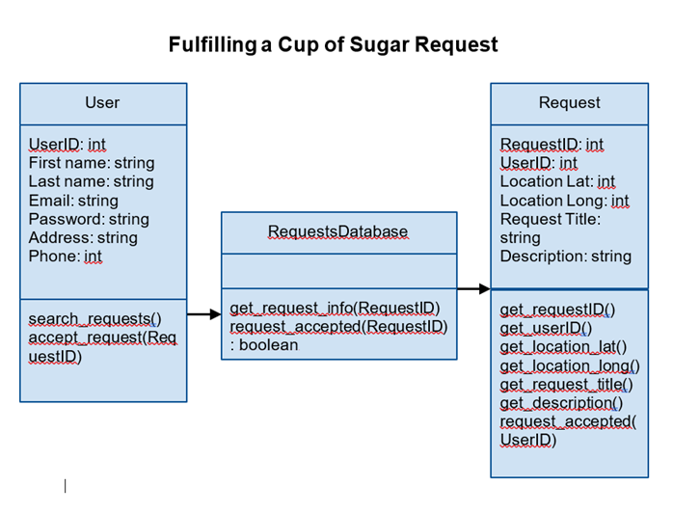
Fulfilling a Cup of Sugar Class Diagram

Slide 7
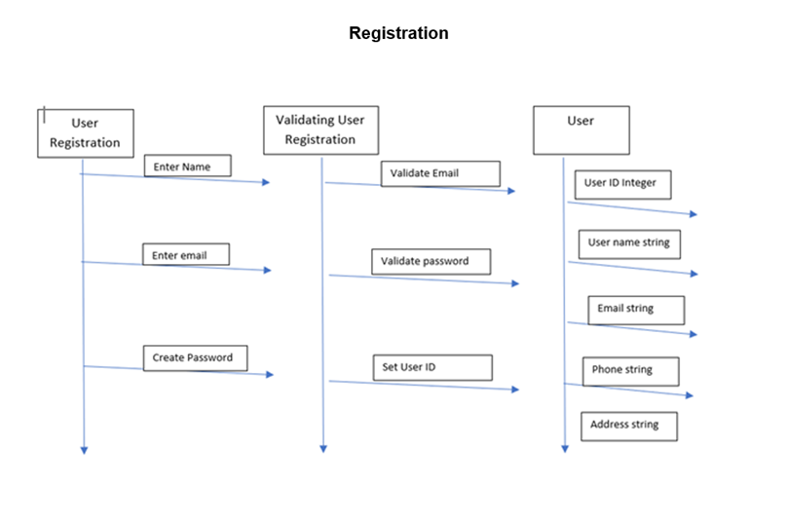
Sequence Diagram

Slide 8
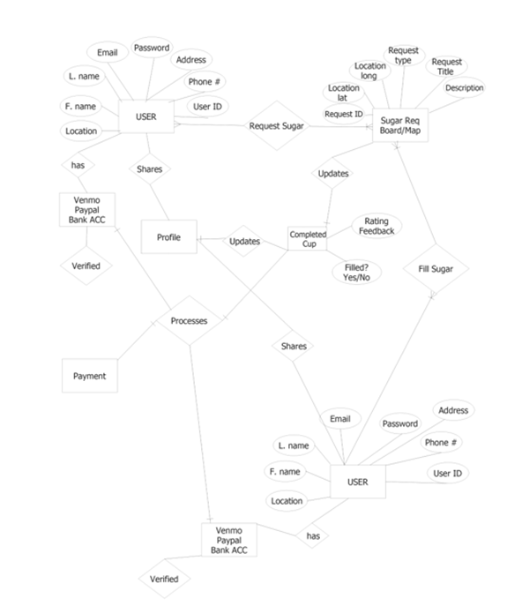
ERD Database Diagram

Slide 9
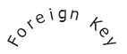
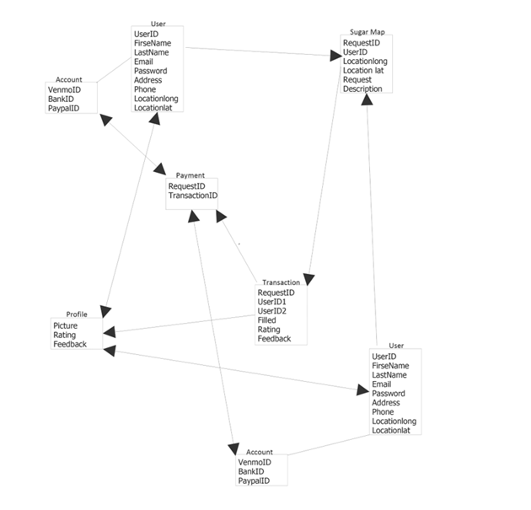
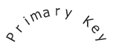
Relational Database Diagram

Slide 10
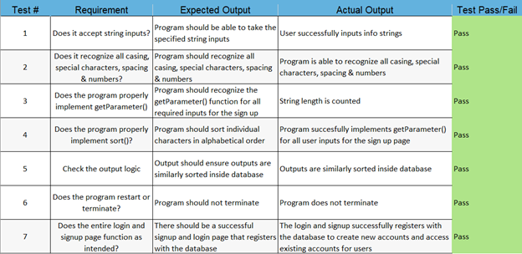
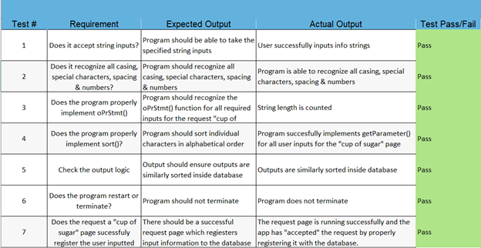
Test Cases

Slide 11
Demo

